Slide 1
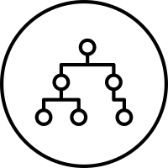
Design and Analysis of Algorithms
Lecture 2: Performance of Algorithms

Slide 2
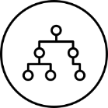
Performance of an Algorithm (1)
An algorithm must be correct, highly readable, and efficient.
By efficient, we mean that the algorithm must use as little memory space as possible and use as little time as possible.
The memory space needed and the time used are called space complexity and time complexity, respectively.
Normally, the two complexities are related to the input size.

Slide 3
Performance of an Algorithm (2)
For example, sorting 10,000 numbers will take much larger space and longer time than that of sorting 100 numbers.
Also, large numbers may take longer time to process than small numbers.
Therefore, the space or time complexity is represented by a function that reflects the relationship between the space or time required by the algorithm and the input size.

Slide 4
Models of Input Size (1)
First Model: Number of Numbers
Use the number of numbers or number of set elements as the input size. For example, if we are given n numbers to sort, then the input size is n.
In this model, we assume one memory cell will hold a number no matter how big the number is.
Moreover, we assume that an operation between any two numbers takes an equal constant time. For example, (5 + 7) will takes the same amount of time as that for (10225560 + 45787899909).
In most cases we use this model.

Slide 5
Models of Input Size (2)
Second Model: Number of Digits
The number of bits (or digits) that are used for encoding the set of input values.
This model uses the number of bits fed into a computer as the input size.
This model is useful when a number is so large such that the assumption that any operation takes a constant time makes no sense.
Moreover, the input may contain only one number or few numbers. For example, if we want to determine if a given number x is a prime number, the input size should not be considered to be one.

Slide 6
Representing Time and Space Complexity (1)
Time Complexity
The time complexity of an algorithm is represented by a function from the input size to the time required by the algorithm to produce corresponding result (we will focus on that).
Space Complexity
The space complexity is represented by a function from the input size to the total number of different memory cells required by the algorithm to produce the result.

Slide 7
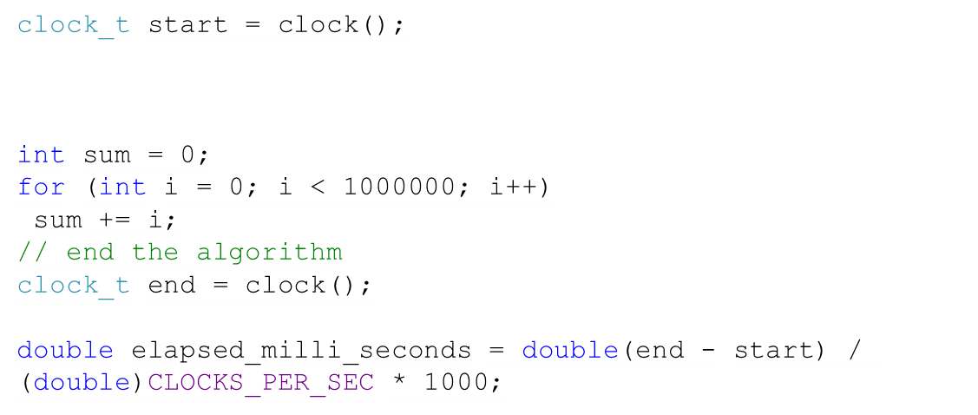
How Can We Measure Algorithm Performance?
We can measure the time using the CPU clock. Programming languages allow measuring the time.
What is the problem with this solution?
The time depends on many factors:
CPU properties
Programming Language
Compiler
Quality of the Algorithm
We want to compare the quality of the algorithm regardless of the CPU, programming language, compiler, etc.

Slide 8
Representing Time Complexity (1)
Because different machines have different speed, the same algorithm may need different time to finish on different machines.
In order to fairly judge the time efficiency of an algorithm, we count the number of basic operations executed by the algorithm and use this number to represent the time complexity of a given algorithm.
This number will not change from one machine to another. Moreover, we also ignore the effect caused by different compilers. We count the number of operations in the pseudo source code.

Slide 9
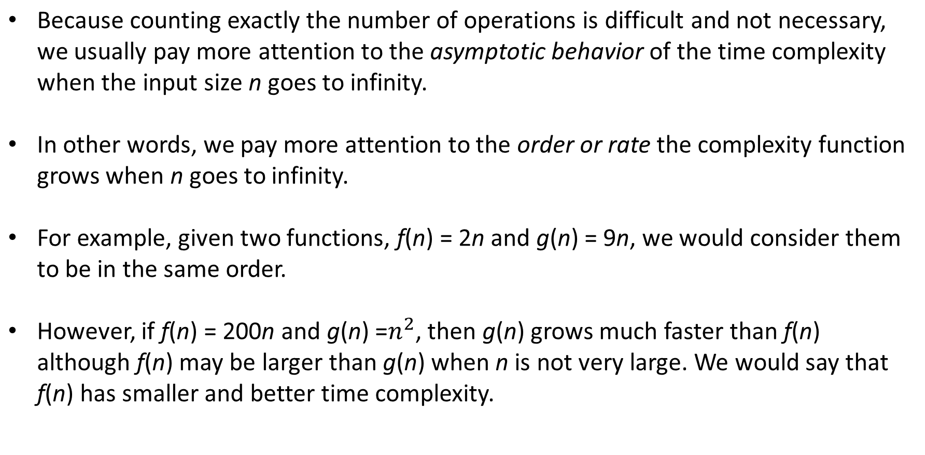
Representing Time Complexity (2)

Slide 10
Growth of Functions – Big O (1)
We introduce some notations used to compare growth rate between two complexity functions.
Definition
Let f(n) and g(n) be two functions from the set of non-negative integers to the set of real numbers.
We say that f(n) is O(g(n)) (often written as f(n) = O(g(n)) if there are positive constant c and n0 such that
f(n) ≤ cg(n) whenever n > n0.

Slide 11
Growth of Functions – Big O (2)
Example
Prove that

Slide 12

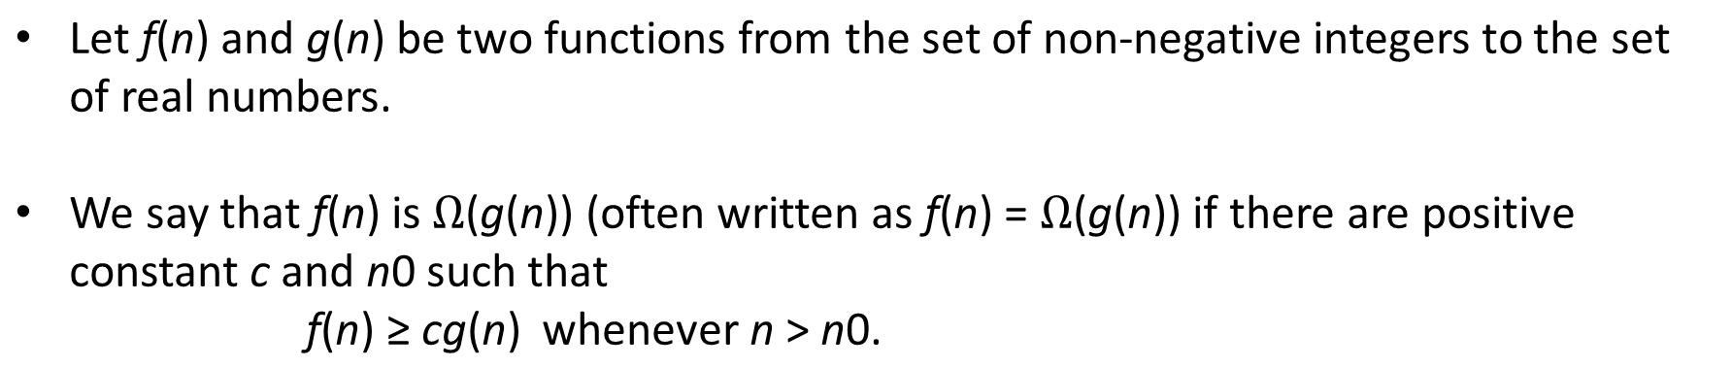
Definition

Slide 13
Growth of Functions – Big Omega (2)
Example
Prove that
Prove that

Slide 14
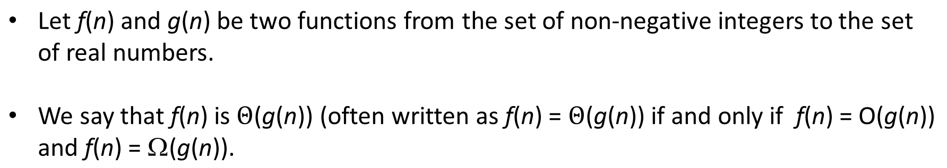
Growth of Functions – Big Theta (1)
Definition

Slide 15
Growth of Functions – Big Theta (2)
Definition

Slide 16

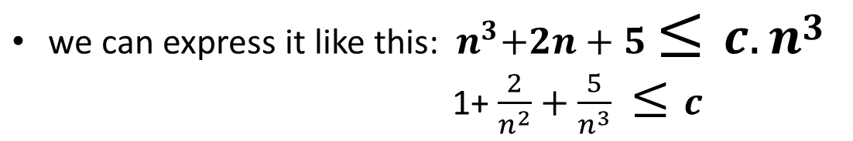


Growth of Functions – Big Theta (3)
Example
Prove that
c = 8, for n > 1

Slide 17
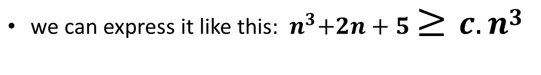

Growth of Functions – Big Theta (4)
Example
Prove that
c = 1, for n > 1

Slide 18
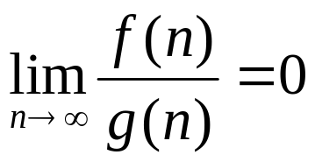
Growth of Functions – Small O
Definition
Let f(n) and g(n) be two functions from the set of non-negative integers to the set of real numbers.
We say that f(n) is o(g(n)) (often written as f(n) = o(g(n)) if:

Slide 19

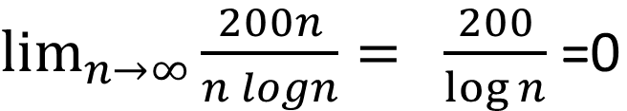
Task
Prove that
200n = o(n logn)

Slide 20
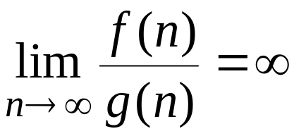
Growth of Functions – Small Omega
Definition
Let f(n) and g(n) be two functions from the set of non-negative integers to the set of real numbers.

Slide 21

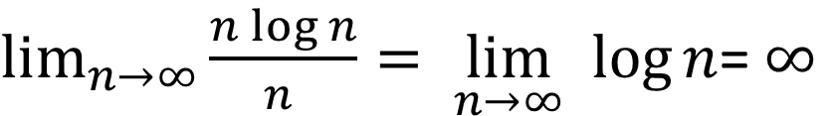
Task
Prove that

Slide 22
Analyzing the Complexity
As we have discussed earlier, we use the total number of operations used by an algorithm as the time complexity.
If we consider the asymptotic complexity, we can further simplify our analysis.
We only need to count the number times the major operation will be executed since it is the one that is executed most often.

Slide 23
Analyzing the Complexity – Example (1)
Procedure Linear search (x, A[1..n])
Input: number x and array A of n numbers
Output: index i if A[i] = x, 0 otherwise.
i ←1
while (i ≤ n and x ≠ A[i])
i ← i + 1
if i ≤ n
then return (i)
else return (0)
End
The major operations in the procedure are the comparisons between x and elements of A.
As we can see that the number of such comparisons is at most n.
If we think of simple operations (such as comparisons, additions, etc.) as operations that cost constant time, then we can say: T(n) is 3n
O(n)=O(4n) = O(n)

Slide 24
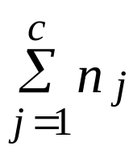
Analyzing the Complexity – Example (2)
The reason behind this is that there are only a small constant number of different kinds of operations in any algorithm.
The commonly used operations include additions, subtractions, multiplications, divisions, data movements, pointer settings, comparisons, and so on.
The number of different operations used by an algorithm is a small constant. Suppose there are c different operations, O1, O2, …, Oc, where O1 is the major operation.
Let Oj be executed nj times. 1 ≤ j ≤ c. Then the total number of operations =
≤ c n1.

Slide 25
Analyzing the Complexity – Example (3)
Also, we assume different operations require an equal amount of time to finish. This assumption is valid from asymptotic point of view. (For example, the multiplication may need 10 times more time than the addition, but the 10 is only a small constant.)
Therefore, T(n) = O(n).
Note. A little care must be taken. The pseudo code may contain some operations that are not basic operations. For example, if the pseudo code contains an operation of
x ← n!
or z ← Min {A[1], A[2], …, A[n]}

Slide 26
Analyzing the Complexity – Example (4)
We cannot consider any of them as a single operation because they represent a single step, not a single operation.
Such a step itself needs many operations depending on the size of n.
We need to analyze how many basic operations to implement them first, and then add to the total number of basic operations.
The integer n itself is treated as a regular variable although it is arguable assumption when n → ∞.

Slide 27
Worst, Best, Average Case (1)
Let’s consider the Linear Search case.
Given an array of n numbers and a number x, if x = A[1], then we are lucky and the algorithm will quickly produce the result.
However, if x is not contained in this array, then the algorithm needs n comparisons, which represents the worst case.
Therefore, the worst case analysis is to get a upper bound on the number of operations the algorithm requires even in the most difficult case. For the linear search algorithm, it is O(n).

Slide 28
Worst, Best, Average Case (2)
The best case analysis is to get an estimate on the minimum number of operations required by the algorithm in most lucky case. In the case of linear search, it is O(1).
The average case analysis is to get an estimate on the average number of operations the algorithm may require over all possible sets of input values. If we assume the x is contained in the array A and has an equal probability 1/n to be A[i], 1 ≤ i ≤ n, then the average complexity of the linear search is (1 + 2 + … + n) / n = (n+1)/2 = O(n).
Usually, we need to know the distribution of all possible sets of input values for the average analysis. The main focus of this book is on the worst case analysis.

Slide 29

Task
Write T(n) and big-O expressions for the following loops.
for(int i=0; i<n-1; i++) {
for(int j=i+1; j<n; j++) {
1 Simple statement
}
}
T(n) =
n-1
+ n-2
+ n-3
for(int j=1; j<n; j++) {
1 Simple statement
}
When i=0, the statement runs for n-1 times
for(int j=2; j<n; j++) {
1 Simple statement
}
When i=1, the statement runs for n-2 times
for(int j=3; j<n; j++) {
1 Simple statement
}
When i=2, the statement runs for n-3 times

Slide 30
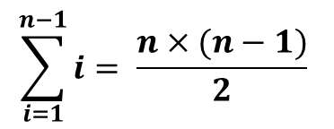
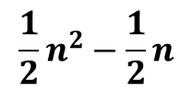
Task
Write T(n) and big-O expressions for the following loops.
for(int i=0; i<n-1; i++) {
for(int j=i+1; j<n; j++) {
1 Simple statement
}
}
+ n-2
+ …. + 2
+ 1
T(n) =
n-1
+ n-3
T(n) =
for(int j=n-2; j<n; j++) {
1 Simple statement
}
When i=n-3, the code runs for 2 times
for(int j=n-1; j<n; j++) {
1 Simple statement
}
When i=n-2, the code runs for 1 time

Slide 31




Task
Write T(n) and big-O expressions for the following loops.
for(int i=0; i<=n; i++)
for(int j=1; j<=n; j++)
for(int k=n; k>=1; k--) {
sum = i+j+k;
cout<< sum << endl;
}

Slide 32
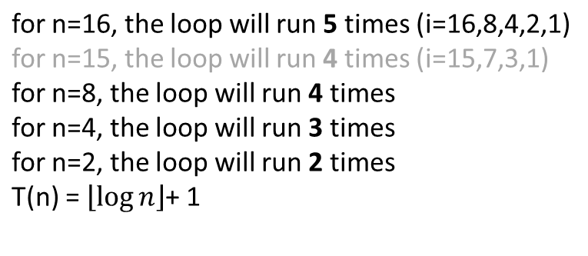
Task
Write T(n) and big-O expressions for the following loops.
for(int i=n;i>0; i/=2)
cout<< i << endl;
O ( log n)

Slide 33

Task
Write T(n) and big-O expressions for the following loops.
int y=0;
for(int j=1; j*j<=n; j++)
//simple statement
When n = 16, it runs for 4 times
When n=4, it runs 2 times
When n=2, it runs 1 time

Slide 34

Task
Write T(n) and big-O expressions for the following loops.
int b=0;
for(int i=0; i<n; i++)
for(int j=0; j<i*n; j++)
b=b+5;
T(n)=0+n+2n+3n+(n-1)n
T(n)=n(0+1+..+n-1)
T(n)=n*n*(n-1)/2

Slide 35

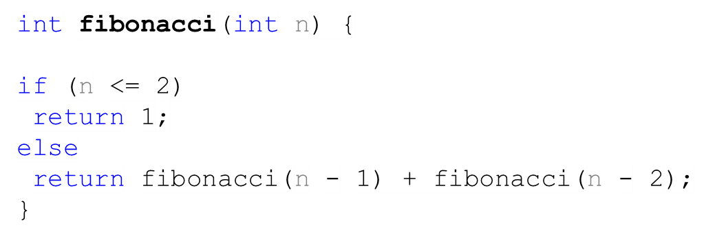



Task
Write T(n) and big-O expressions for the following algorithm:
5
fibonacci(5)
3
2
fibonacci(4)
fibonacci(3)
2
1
1
1
fibonacci(3)
fibonacci(2)
fibonacci(2)
fibonacci(1)
1
1
fibonacci(2)
fibonacci(1)
Notes:
nT(n

Slide 36
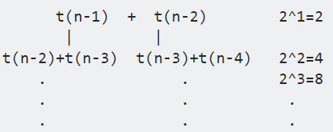
Solution
T(n) = 1 when n<=2 T(n) = T(n-1)+ T(n-2)
Notes:
nT(n

